Slide 1
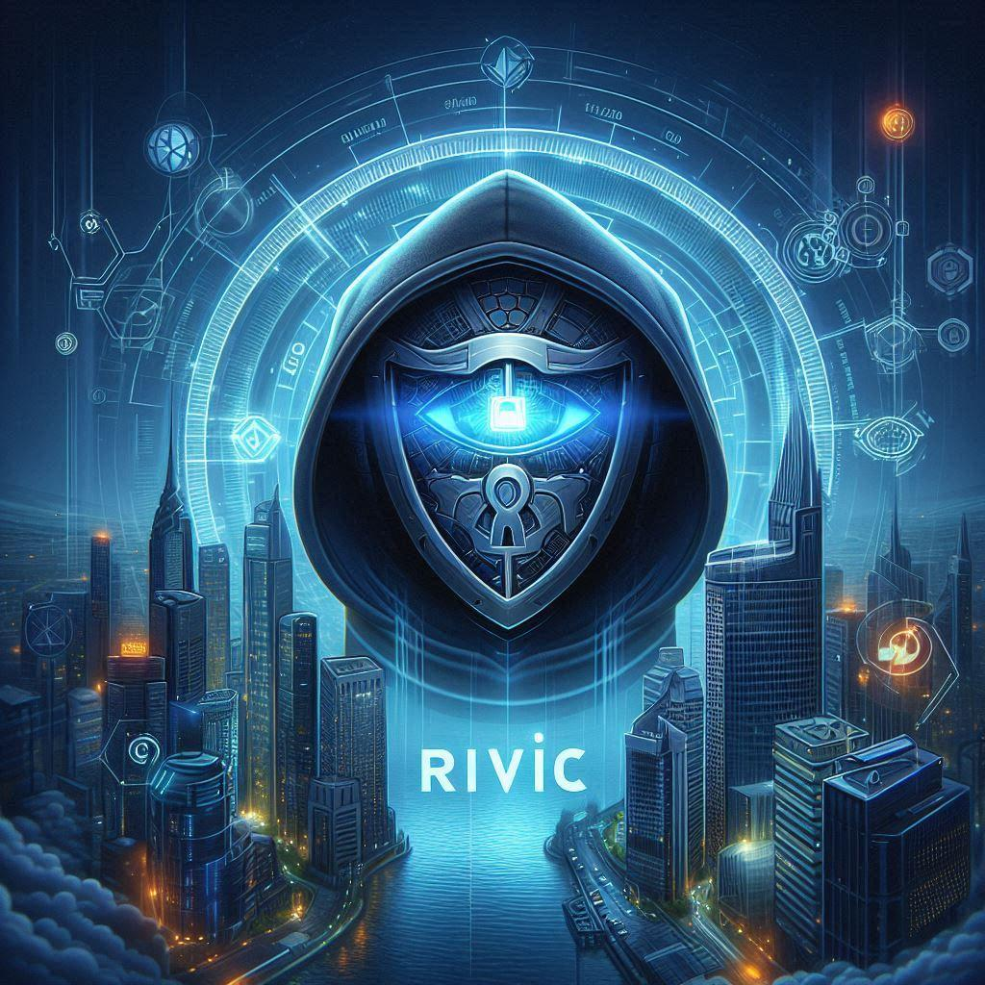
RIVIC
Robust Integrated Verified Identity Chain
Unmatched Digital Security

Slide 2
Overview: RIVIC is a cutting-edge blockchain-based digital identity solution designed to address the growing challenges of identity security and privacy in the Web3 era. It combines advanced cryptography, decentralized technology, and user-centric design to create a robust, integrated system for identity verification and protection.
Mission Statement: "Fortifying Digital Identities with Unmatched Security"

Slide 3
The Problem
Current Issues:
Increasing rates of identity theft and fraud
Lack of user control over personal data
Centralized systems vulnerable to breaches
Complex and fragmented identity verification processes
Privacy concerns in data collection and storage
Statistics:
Identity theft affected 14.4 million consumers in 2022, causing $52 billion in losses (Javelin Strategy & Research)
80% of consumers are concerned about how companies use their data (Pew Research Center)
The average cost of a data breach reached $4.35 million in 2022 (IBM Cost of a Data Breach Report)

Slide 4
The Solution
RIVIC's Approach:
Decentralized identity management using blockchain technology
Self-sovereign identity principles allowing users to control their data
Zero-knowledge proofs for privacy-preserving verification
Interoperable standards for seamless integration across platforms
Key Features:
Robust security: Cryptographic protection and distributed storage
Integrated solutions: Seamless identity verification across various services
Verified identities: Trustworthy and tamper-proof identity claims
Privacy-first approach: Minimal data disclosure and user consent mechanisms

Slide 5
Technology
Blockchain Technology:
Utilizes a permissioned blockchain for enhanced security and scalability
Smart contracts for automated and transparent identity processes
Distributed ledger technology ensures data integrity and availability
Security Protocols:
Multi-factor authentication
Biometric verification
Decentralized key management
Encrypted data storage and transmission

Slide 6
How It Works
Process Flow:
User creates a RIVIC identity wallet
Identity claims are verified and stored on the blockchain
Users control access to their identity information
Verifiers request specific data with user consent
Zero-knowledge proofs confirm information without revealing raw data
User Experience:
Intuitive mobile app for identity management
Simple consent mechanisms for data sharing
Seamless integration with partner services and applications

Slide 7
Benefits
For Users:
Enhanced security against identity theft
Full control over personal information sharing
Reduced need for multiple accounts and passwords
Streamlined access to services with quick verification
For Businesses:
Trustworthy and efficient identity verification
Reduced liability for storing sensitive user data
Improved compliance with data protection regulations
Enhanced customer trust and loyalty

Slide 8
Market Opportunity
Market Size:
The global digital identity solutions market is expected to reach $49.5 billion by 2026 (MarketsandMarkets)
Growth Potential:
CAGR of 16.2% from 2021 to 2026
Increasing demand for passwordless authentication
Growing adoption of blockchain technology across industries

Slide 9
Conclusion
Recap:
RIVIC offers a revolutionary approach to digital identity
Combining security, privacy, and user control
Vast market potential with a clear competitive edge
Call to Action:
Join the RIVIC ecosystem as an early adopter
Partner with us to integrate secure identity solutions
Invest in the future of digital identity management
Contact : Revan Ande (revan.ande98@gmail.com) , Twitter: https://x.com/Revanande

